Slide 2
Transitioning to the Long Term
Michael Gunderson

Slide 3
Transitioning to the Long-Term

Slide 4
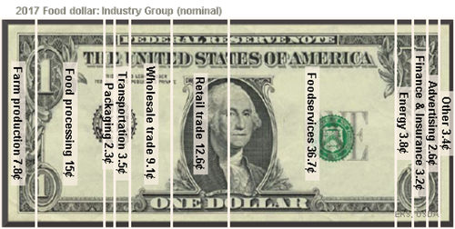
Share of the US Food Dollar, Source: USDA Economic Research Service

Slide 5
Farm Production Share of Food Dollar, Source: USDA Economic Research Service

Slide 6
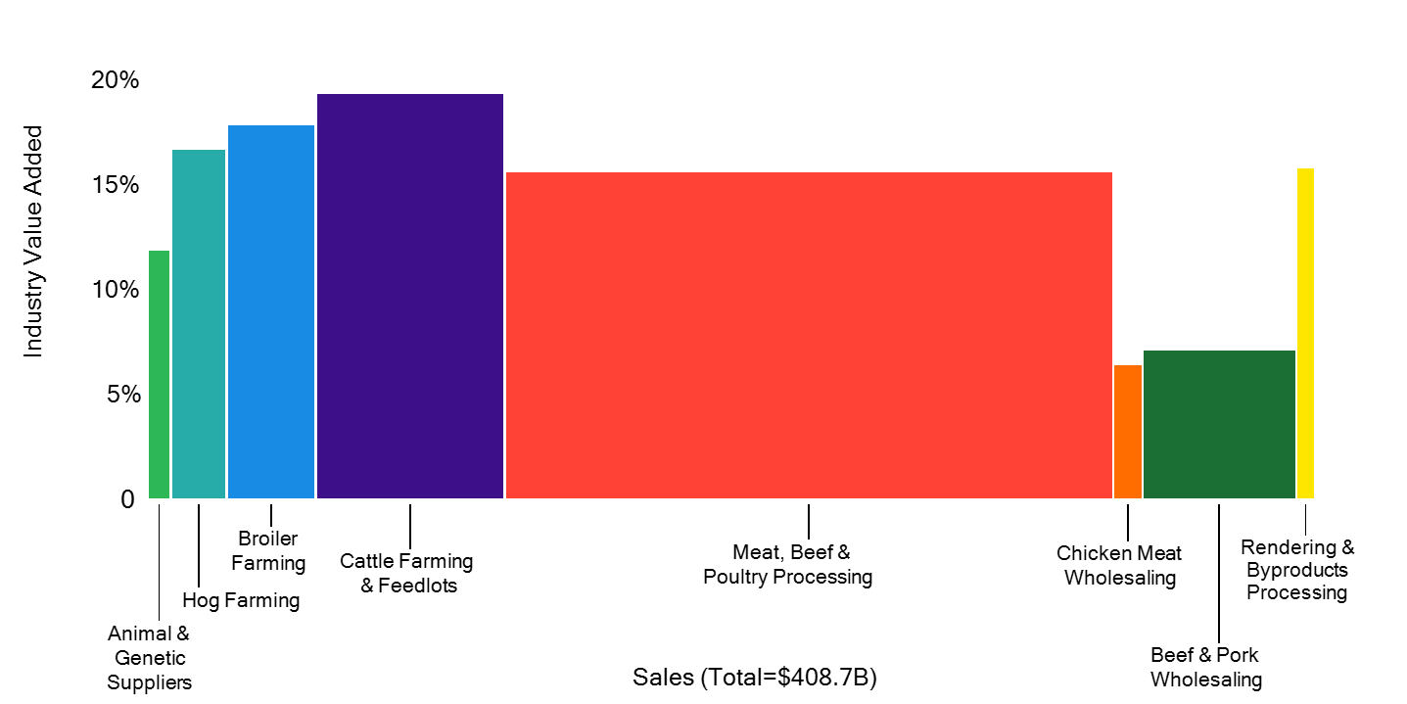
U.S. Animal Protein Industry Profit Pool
2018
Source: IBISWorld, Wes Davis Thesis
¹ Animal & Genetic Suppliers includes livestock breeding services, genetics suppliers, and cattle and hog stockers and breeders
² Rendering & Byproducts Processing includes rendering and meat byproduct processing, and leather tanning and finishing

Slide 7
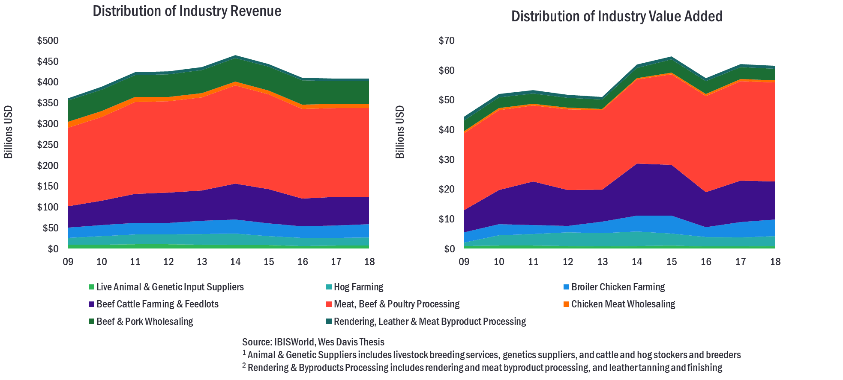

Slide 8
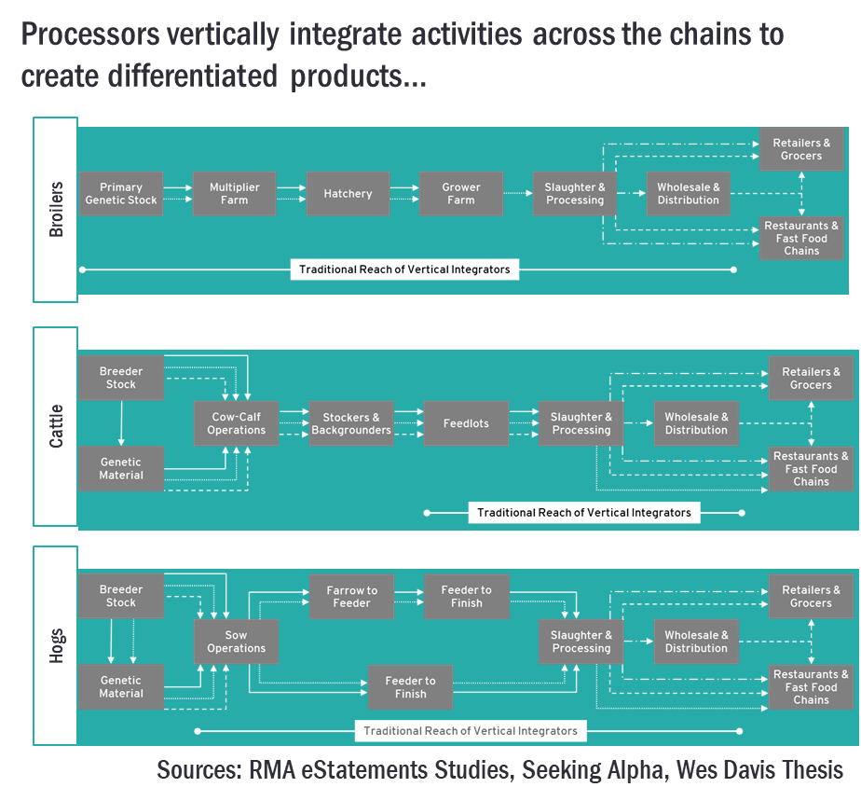

Slide 9
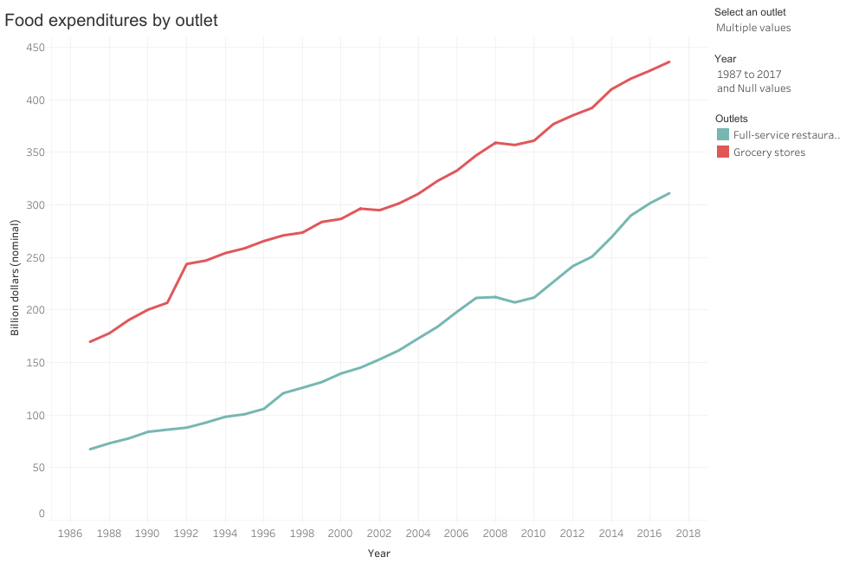
Source: USDA Economic Research Service, Food Expenditure Series

Slide 10
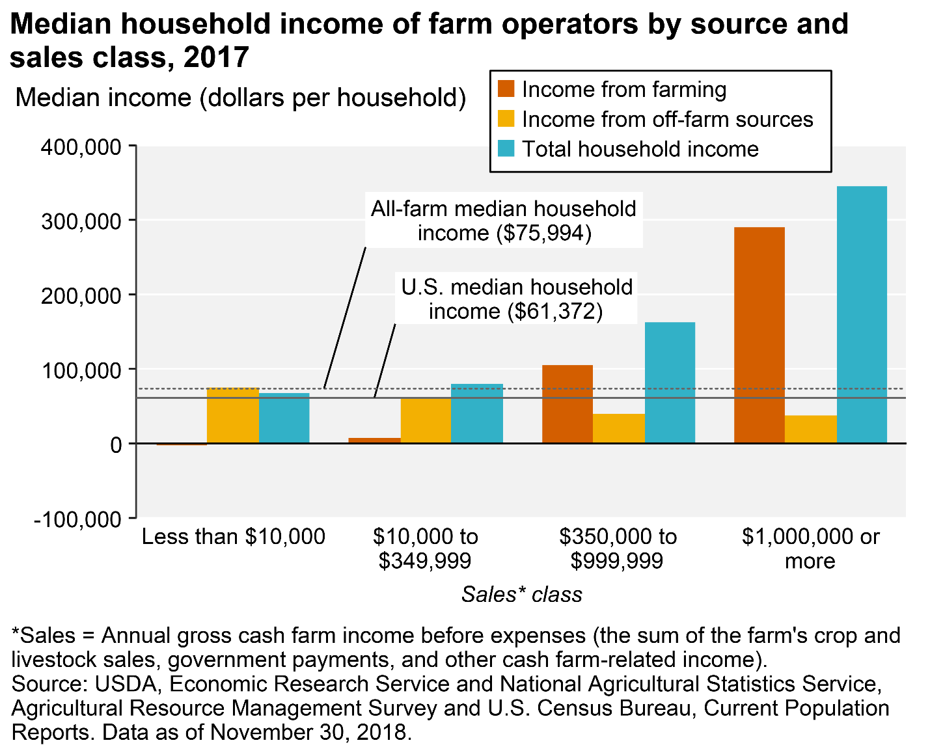

Slide 11
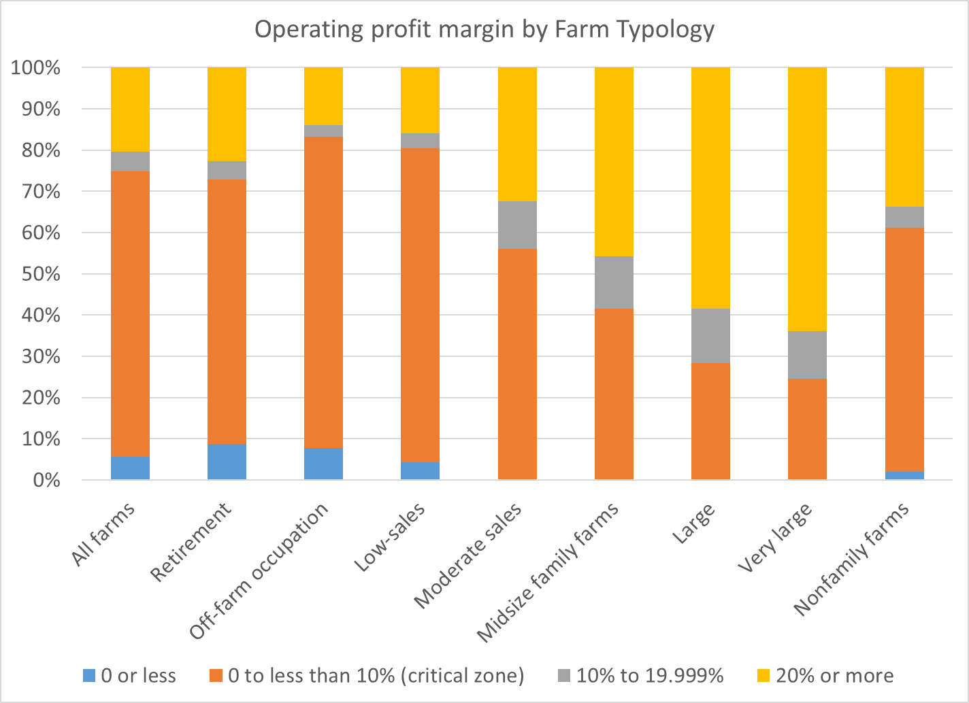
USDA ERS
Amber Waves (2015)
Profit Margin Increases With Farm Size
by Robert Hoppe

Slide 12
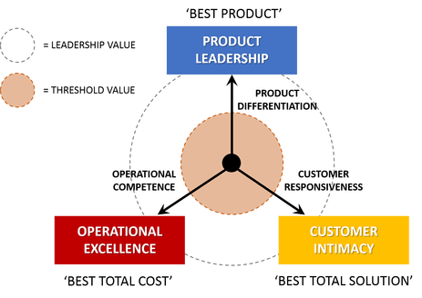
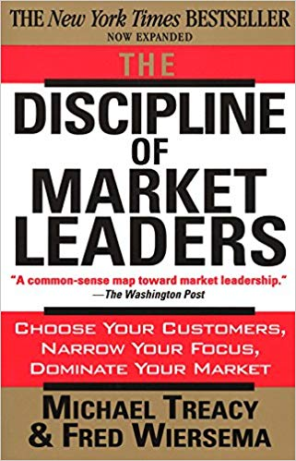

Slide 13
Operational Excellence
Agricultural Production’s Traditional Market Value

Slide 14
Source: USDA Economic Research Service
Inflation Adjusted using GDP Deflator from US Bureau of Economic Analysis

Slide 17
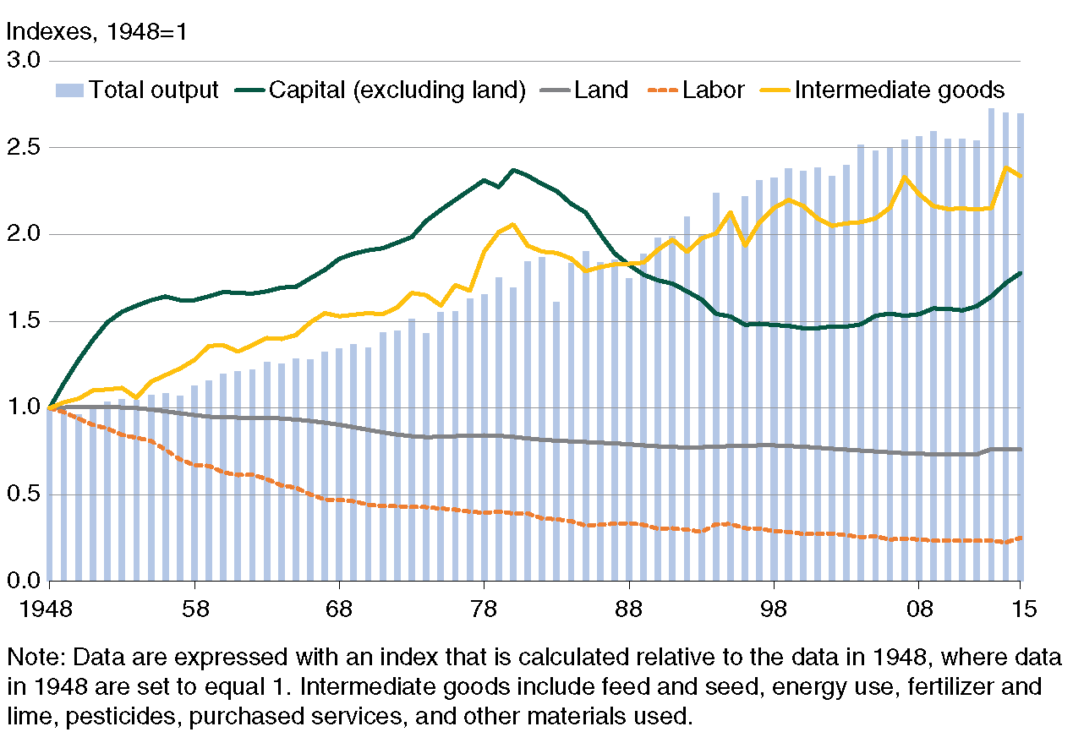
USDA ERS
Amber Waves (2018) Agricultural Productivity Growth in the United States: 1948-2015
Wang, Nehring, and Mosheim

Slide 18
Product Excellence
Creating Value through Product Differentiation

Slide 19
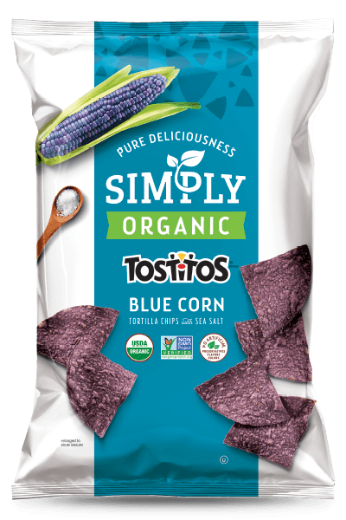
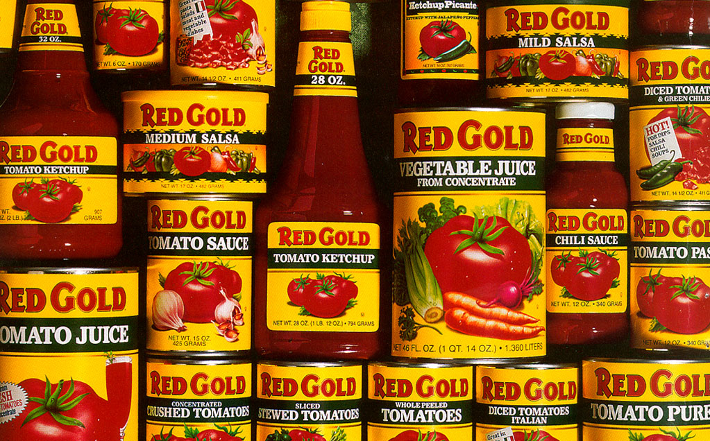
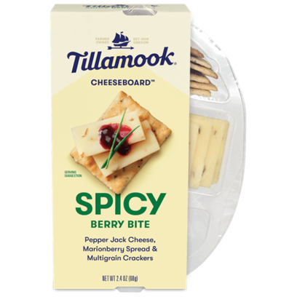
Consumers Driving Product Quality

Slide 21
Customer Intimacy
Creating Value through Close Value Chain Relationships

Slide 22
Closely Coordinated Customer Relationships
Close coordination with end consumers
Agricultural Tourism
Community Sponsored Agriculture
Close coordination with restaurants and chefs
Close coordination with food processors

Slide 27
Michael Gunderson
mgunders@purdue.edu

